Slide 1
MRS Phase 4 Plan
11/08/2026

Slide 2
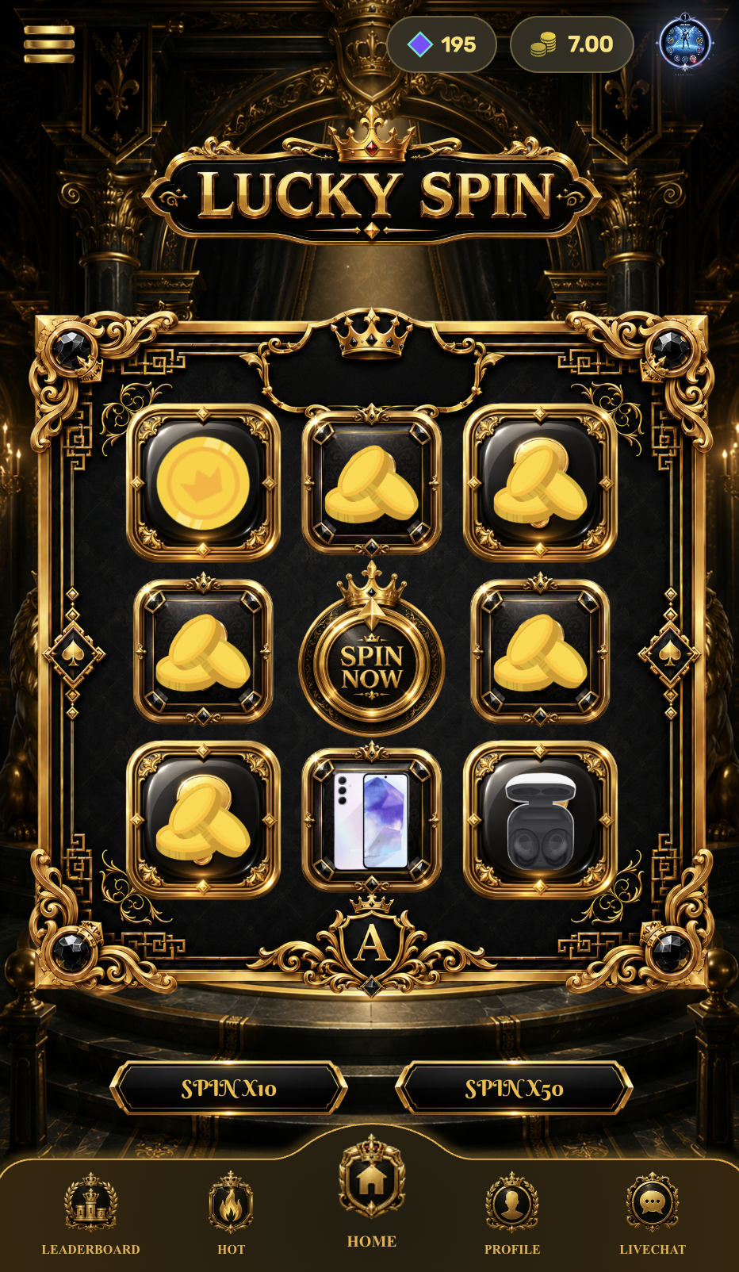


Change the Token and Battle Point icons for all station.
Please apply this change across all MRS mini games, not only Lucky Spin.
Affected pages:
Lucky Spin
Penalty Kick
Smash Egg
Avatar
Any other mini game pages that display Token / Battle Point icons
Keep the existing layout and design. Only replace the icons.
Battle Point
Sample icon
Token
Sample icon

Slide 3
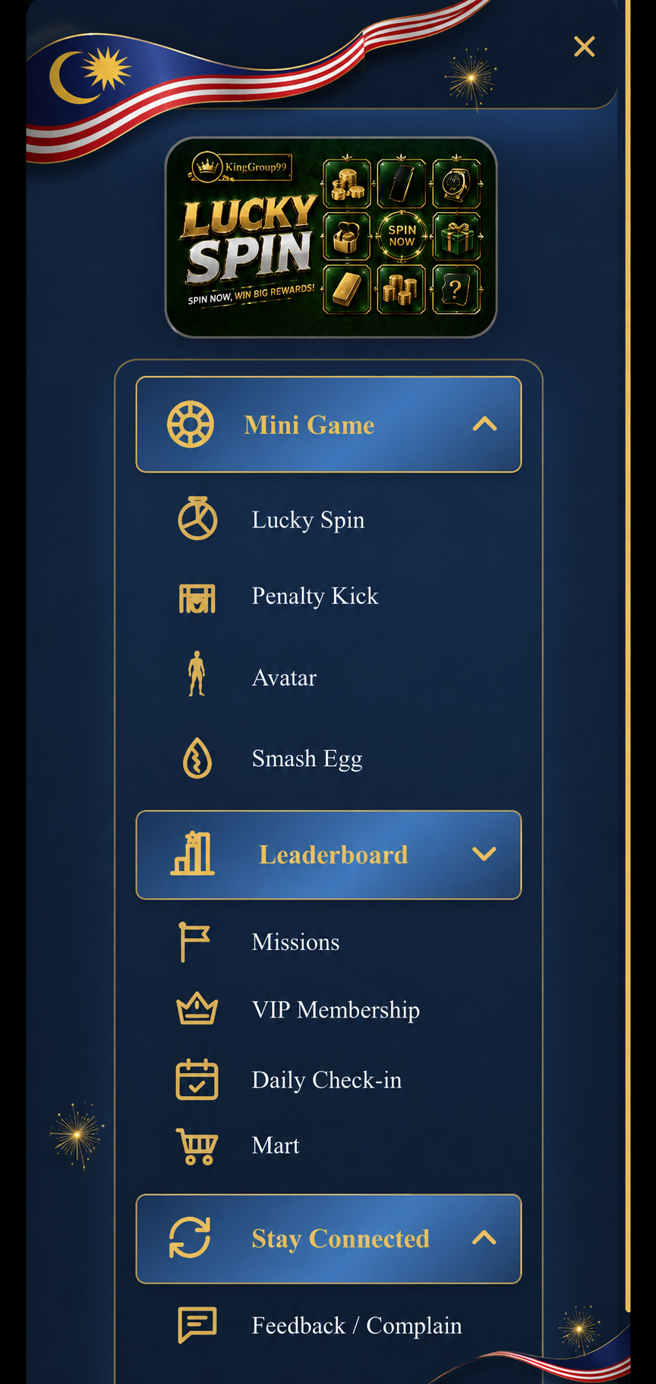
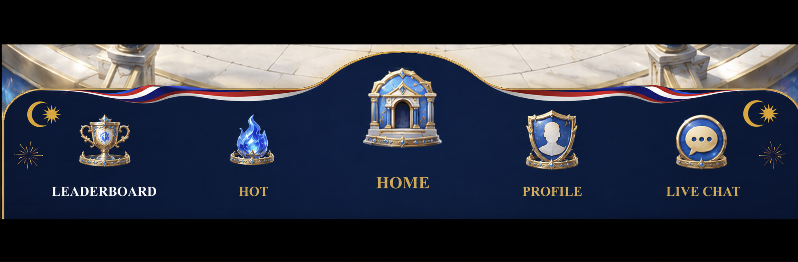
For All Station – Add National Day elements to:
1. Menu Bar
2. Bottom Navigation Bar
Keep the existing background, theme, and overall UI design unchanged.
Only add simple National Day decorations/elements to these two areas.

Slide 4
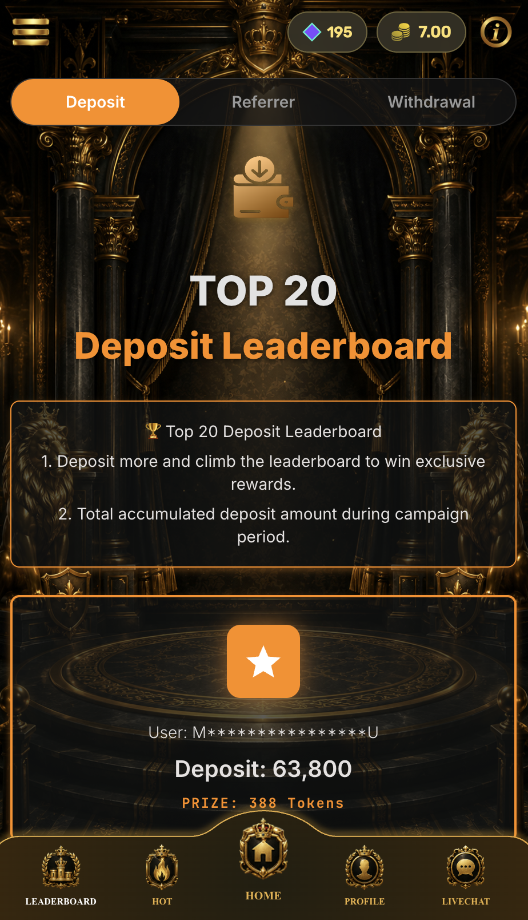
All Station
Add New Leaderboard:
Top Turnover Leaderboard
Purpose:
Create a new leaderboard for the National Day Event (31/8 – 16/9).
Ranking Calculation:
Ranking is based on Total Turnover (Total Bet).
Only count turnover generated during the event period (31/8 00:00 – 16/9 23:59 GMT+8).
Note:
It will be a separate leaderboard
Maintenance button will separate with other leaderboard

Slide 5
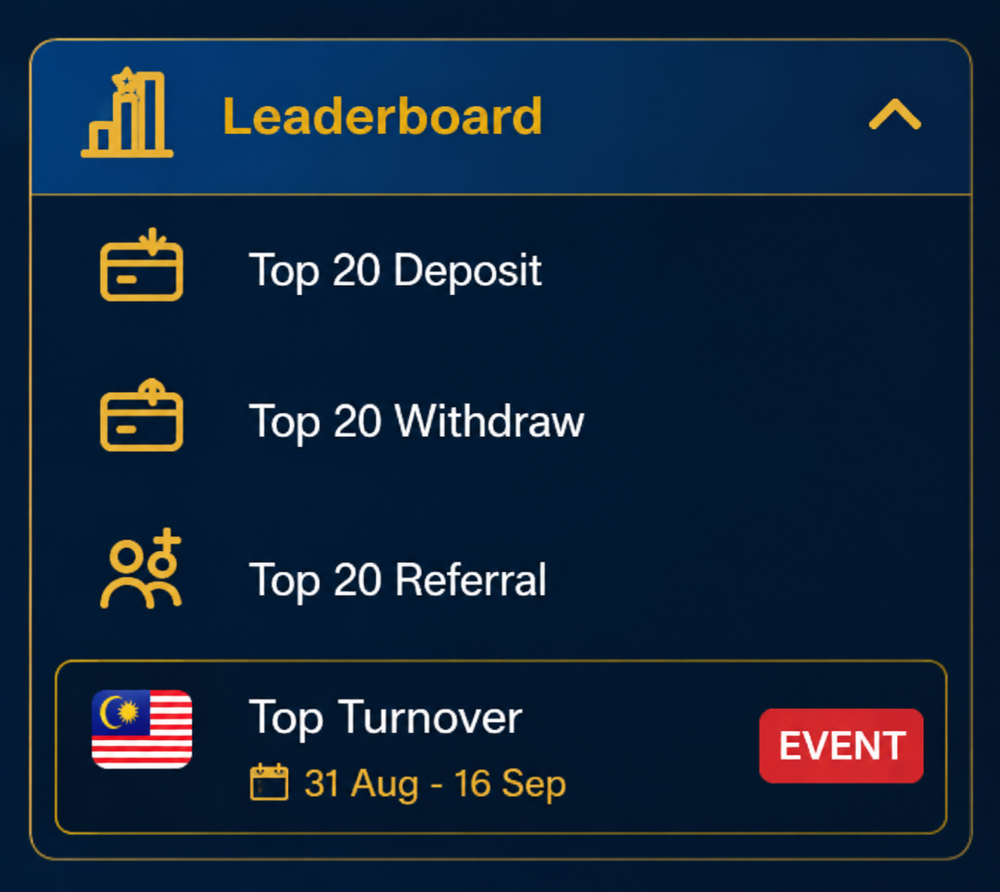
Top Turnover Leaderboard Event
Add Top Turnover under Leaderboard.
Add EVENT label.
Show event period below: 31 Aug - 16 Sep
Same style as current Leaderboard menu.

Slide 6
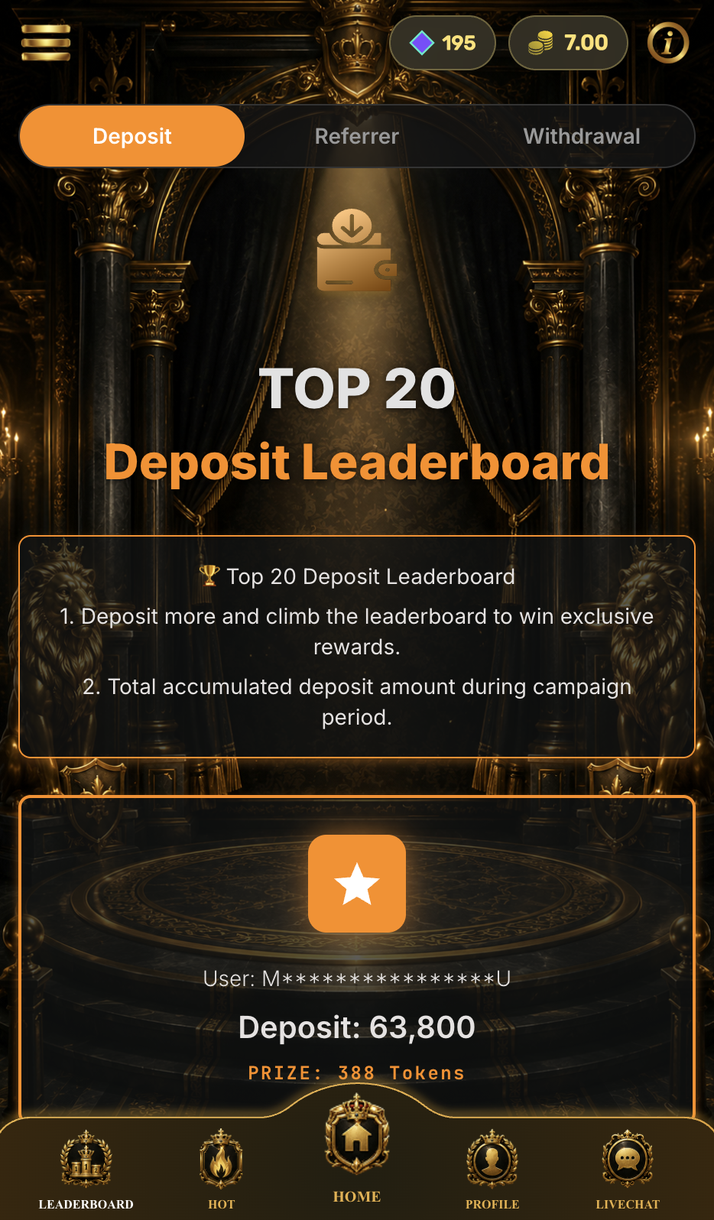
All Leaderboard – Replace with My Rank Section
Please replace the existing “Top 20 All Leaderboard” section with a “My Rank” section.
The My Rank section should display:
Member’s actual current ranking
Member’s current Total Turnover
Additional turnover required to reach the next rank
Progress bar toward the next rank
The member’s actual ranking must be displayed even if they are outside the Top 20.
Example:
Rank #186
Total Deposit : RM25,680
RM1,250 more to reach Rank #185

